Slide 1

Smart Drip Chamber
Anish Malladi
Arnold Wey
Gordon Macshane
Vishnu Kaimal
Yeonwoo Lee

Slide 2
The Problem

Slide 3

Low Fluid Levels
Overworked Staff
Delivery precision

Slide 4


The Solution
Use a Spark Core to connect drip chamber to Hospital records

Slide 5
The End User vs the Buyer
Nurses?
Doctors
Hospitals?
VACs?
Distributors?

Slide 6
How do we take such a product to market?
Notes:
The Hospital personnel and Biomedical experts we solicited for help often contributed feedback on the device's functionality, but gave no clue as to how to make the Smart Chamber a reality in hospitals across not only the United States, but the entire world.
In order to approach Distributors and Manufacturers for Manufacturing or Licensing agreements, we first need to secure a patent for our product. From here it’s just simply finding any one of Medical Action Industries, Cardinal Health, Medline, or Dickinson and Co. and negotiate an agreement.

Slide 7
Dr. Jessica Robinson-Papp, MD
– Doctor at Beth Israel
Notes:
HOWEVER, she wasn’t sure who purchased Medical supplies at Mt. Sinai
Tel: 212-241-8390

Slide 8
Dr. Chaitan Devulapalli
– Doctor at Washington Brain and Spine Institute

Slide 9
Kenneth A. Pascale
- Ideas on policy compliance

Slide 10
Ryan Oeullet
– Of supply chains for hospitals

Slide 11
The Value Assessment Committee
– The people who decide whether a product is worth it or not
Notes:
http://www.mddionline.com/article/strategies-medical-device-manufacturers-address-hospital-value-analysis
In the past, physician preference primarily drove device usage.

Slide 12
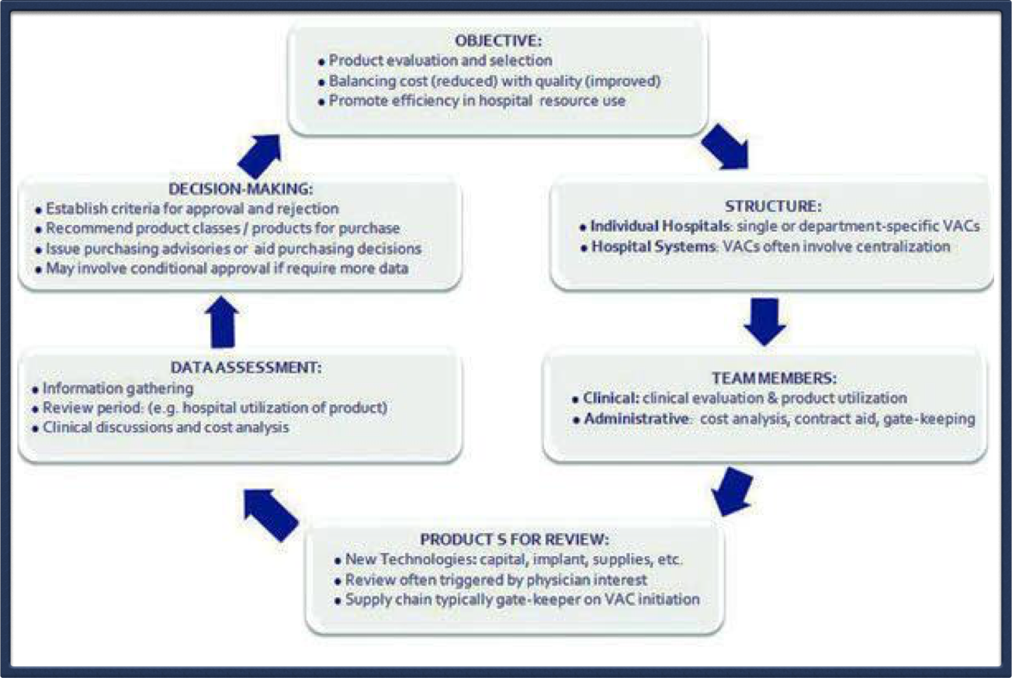
VAC Decision Flow

Slide 13
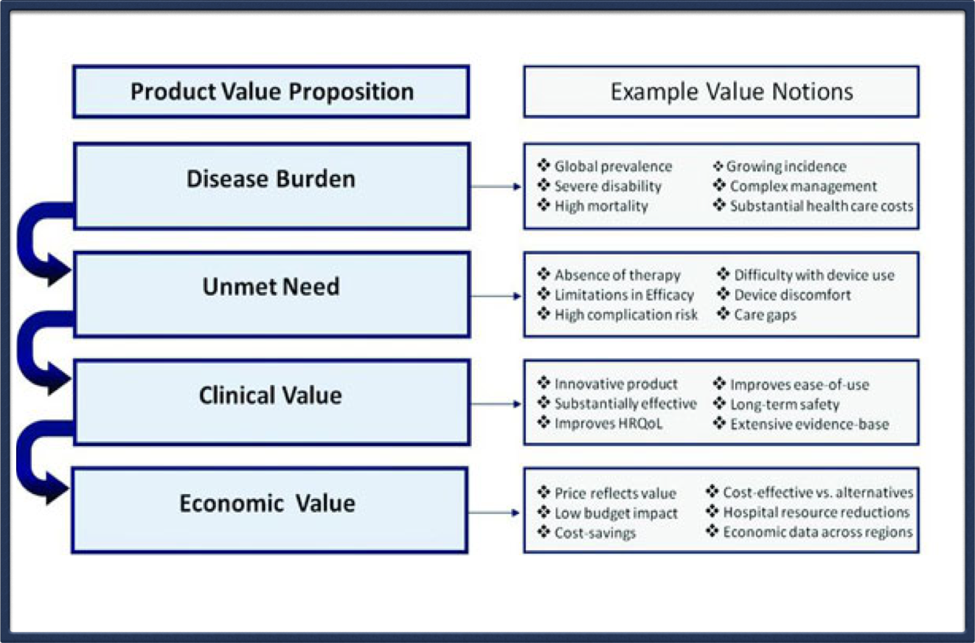
Value Proposition

Slide 14
Steve Everly
– Trade Show Coordinator

Slide 15
Medline
Awaiting Response

Slide 16

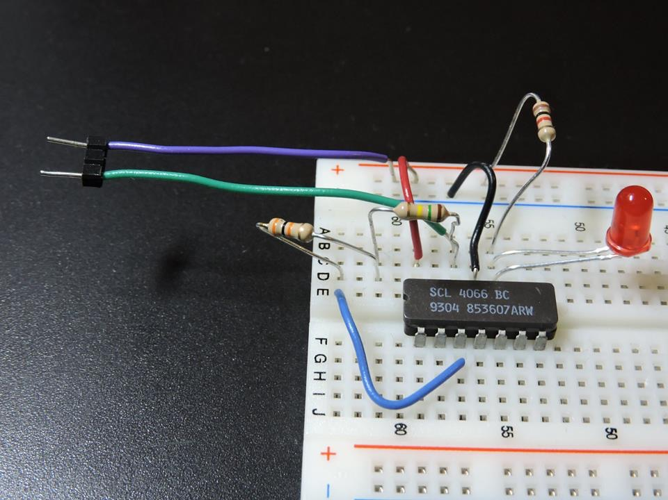
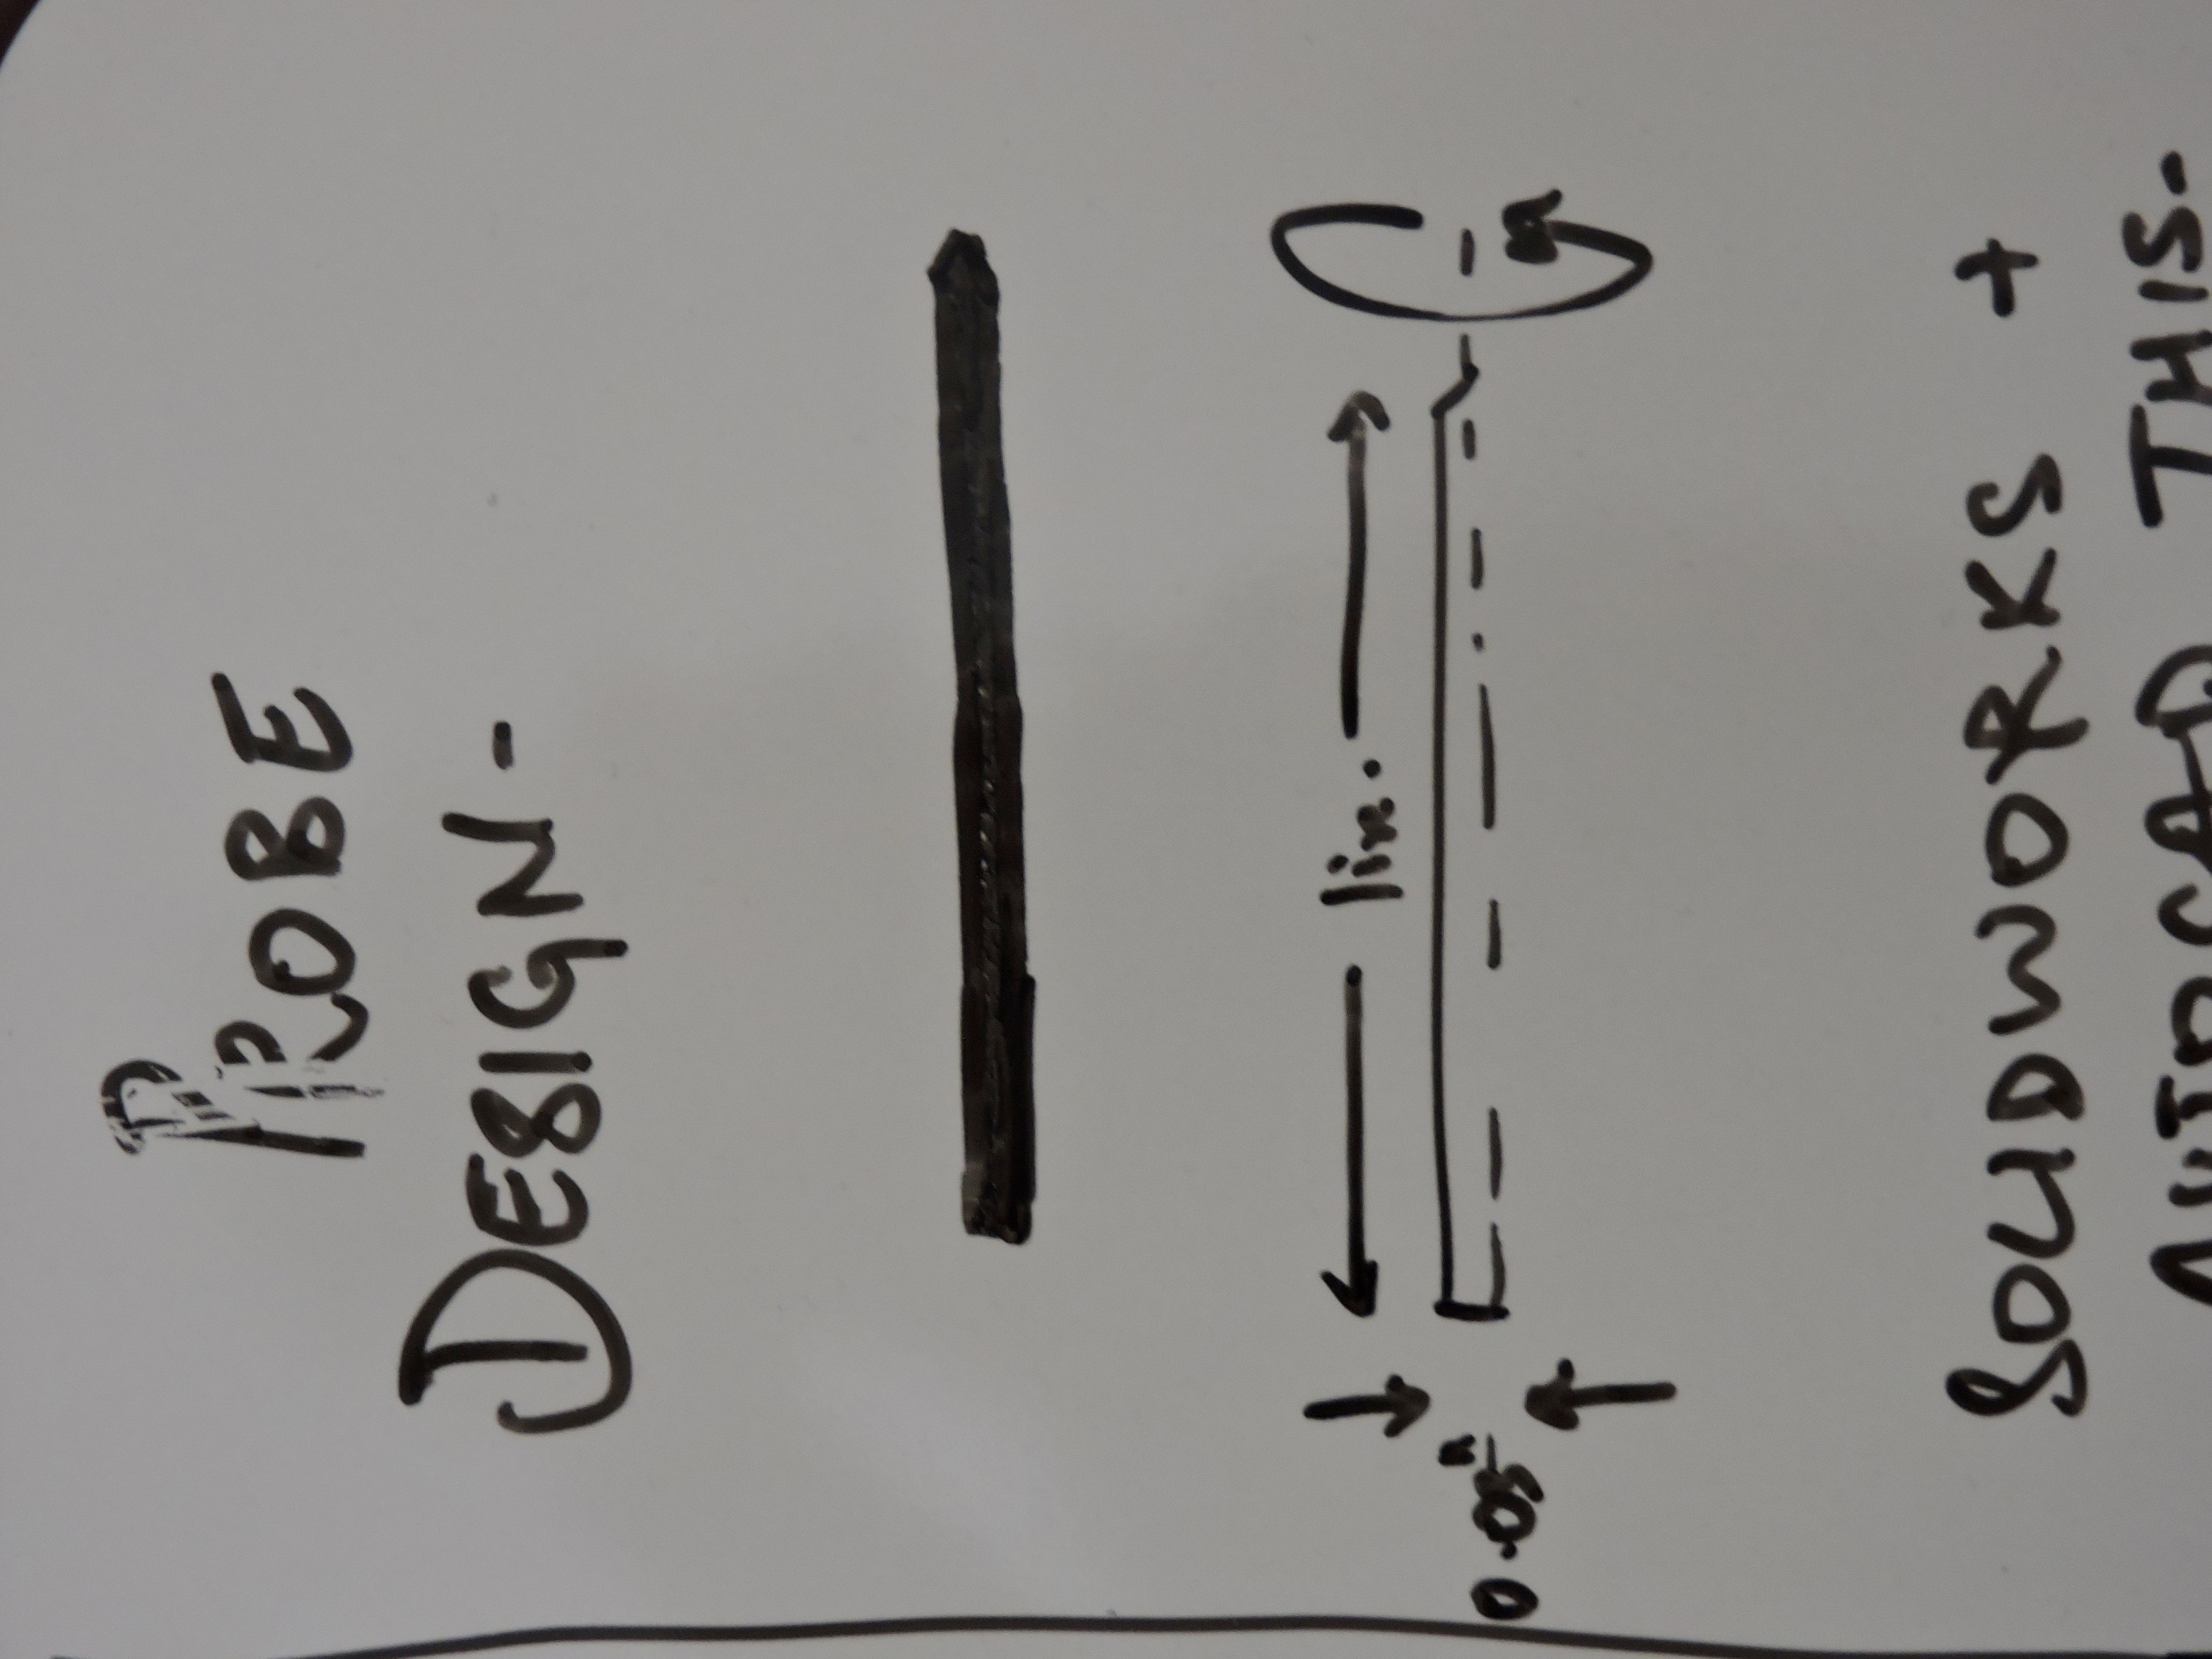
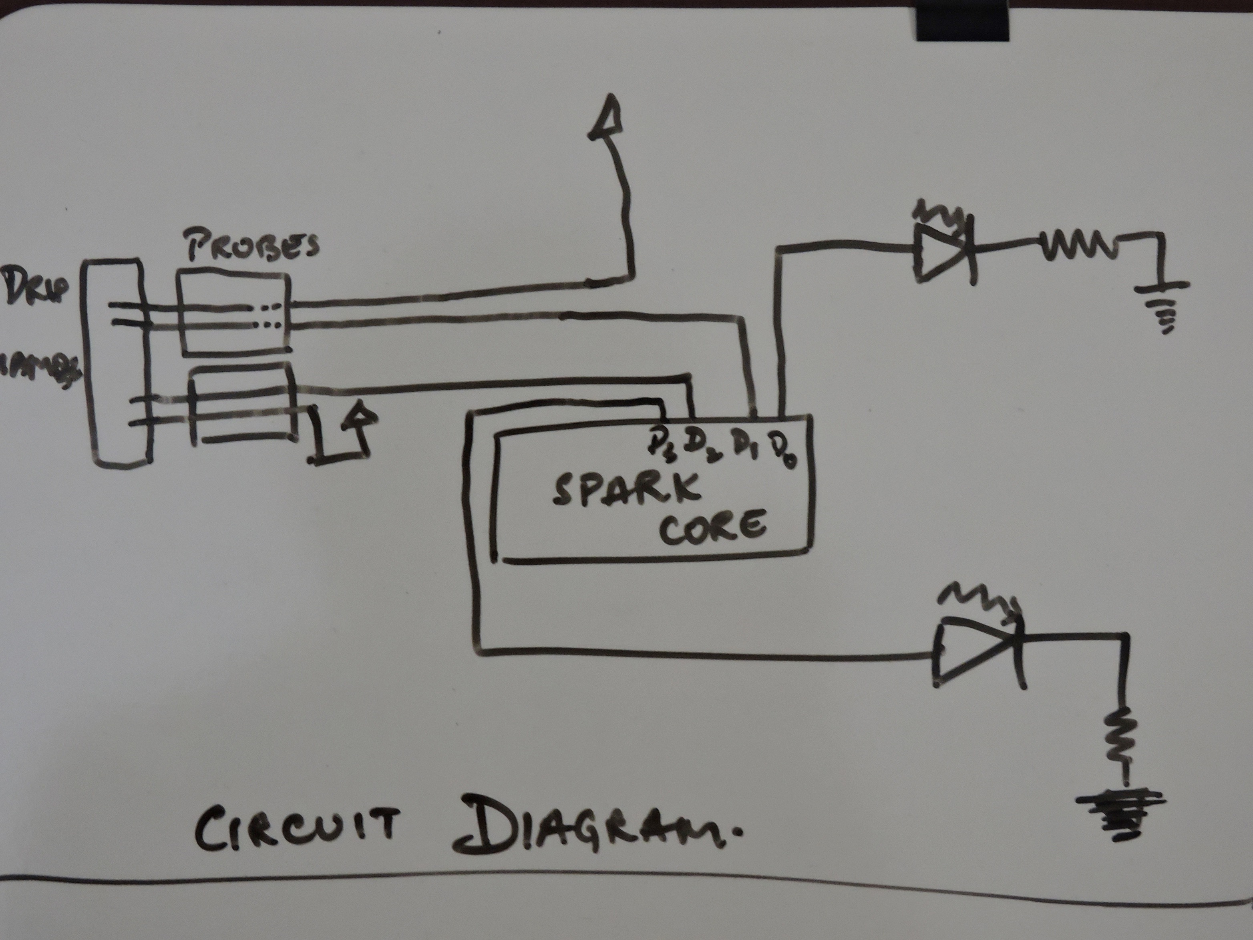

Slide 17
Kickstarter
Created a faux Kickstarter page
Creating a video to upload to page
Rewards to backers decided

Slide 18
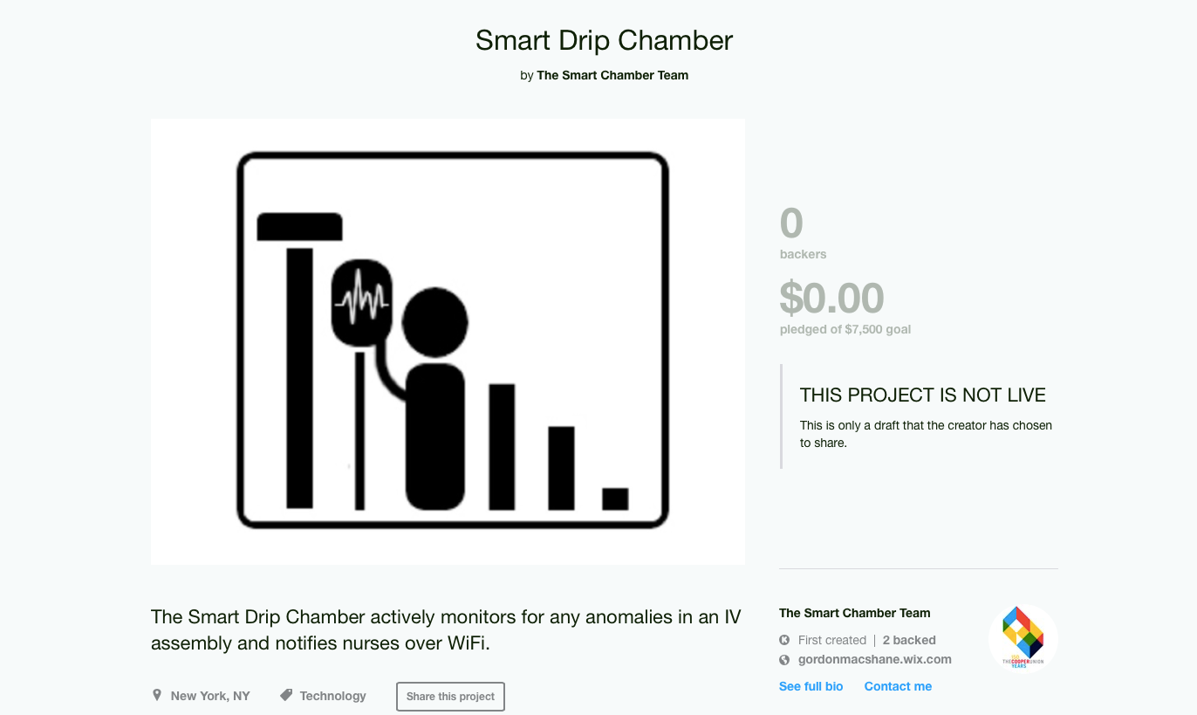

Slide 19
Thank You

